Slide 1
The Fresh Queen of Bee-lair
By Dannica Andriet, Roehm Bergen, Courtney Lovbakke, Madeline Samuel, and Colleen Wyering

Slide 2
“Now this is the story all about how
My life got flipped, turned upside down
And I'd like to take a minute just sit right there
I'll tell you how I became the queen of a hive called Bee-lair”

Slide 3
“In rural Alberta born and raised
In the cornfields where I spent most of my days
Pollinating crops, in a good mood...

Slide 4
“Making over two-thirds of all of your food”
Roughly 70% of food crops are pollinated by bees

Slide 5
“When a couple of mites, they were up to no good
Causing colony collapse in my neighbourhood
I got one on my tummy and my mom got scared
She said "You're moving to the city to a new hive; Bee-lair"

Slide 6
“As our colony grew we decided to swarm
We were docile, but still caused quite an alarm
The humans called a beekeeper who came and grabbed us for free
He drove us away, and into the city”

Slide 7
“First class, yo, this is great.
There’s less pesticides in this urban landscape.
Is this what the urban city bees living like?
Hmm, this might bee all right”

Slide 8
“Buzz is, I hear they're happy, healthy, and free.
This is the perfect place to have sent this cool bee!
With my wings ready for when I get there.
I hope they're prepared for the Queen of Bee-lair”

Slide 9
Mites!
Varroa destructor mites are parasites to bees
Attach to the abdomen of bees and feed off them
Attracted more to larger colonies
Can wipe out entire colonies (aka colony collapse)

Slide 10
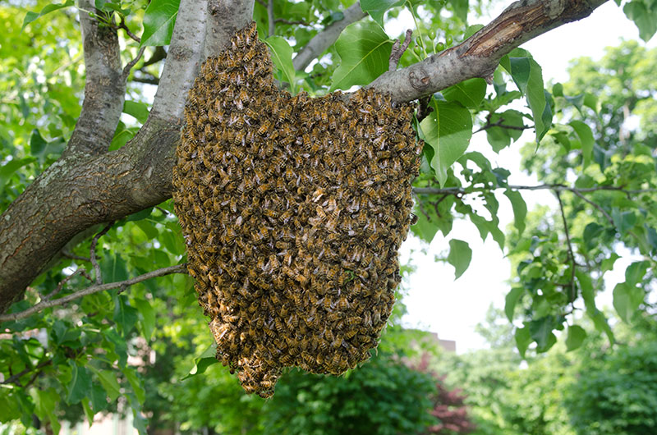
Bee Swarms
Bees swarms occur when a colony grows too big and split into two colonies!
The bees that are going to form a new colony swarm around their queen and leave to find a new home.
It may look like they are quite threatening at this state but are actually quite docile!
In order to deal with a swarm all that needs to be done is for individuals to call the City of Edmonton and they will send someone for free to deal with it

Slide 11
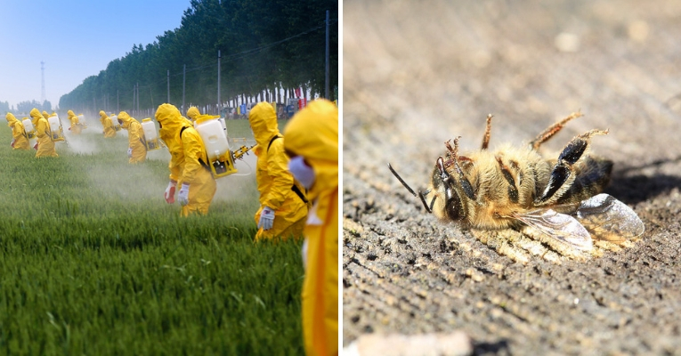
Pesticides
Urban environments provide bees with minimal exposure to lethal doses of pesticides which are common in commercial agricultural environments.
Less exposure to pesticides leads to increased population sizes.

Slide 12
“When we arrived, I flew up into the air. There were community gardens for local food, everywhere”

Slide 13
“Why the city needs more bees is becoming quite clear. No wonder urban beekeeping is popular here”

Slide 14
“There’s lots of different plants in my new urban digs. The diversity is good for my new queenly gig”

Slide 15
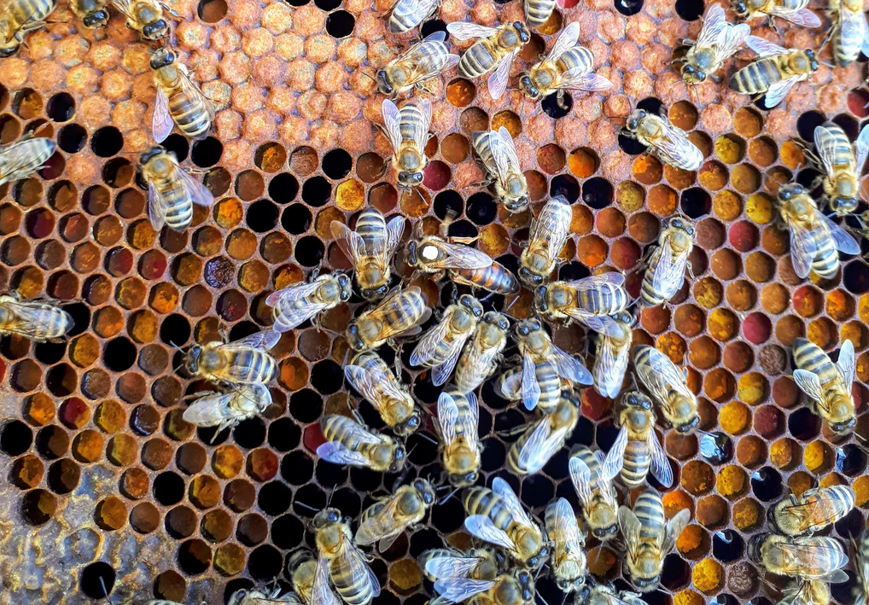
“If anything I could say this new hive has flair. And I thought, yeah that’s it, my home’s in Bee-lair!”

Slide 16
Community Gardens
With the growing interest in locally sourced food, community gardens and urban beekeeping have exploded in popularity in cities.
The increase in community gardens, and urban gardening in general have increased the need for pollinators.

Slide 17
Urban Beekeeping
In the last decade, there has been a sharp increase in the number of urban beekeepers, particularly in larger cities.
Increase in its popularity has increased with popularity in sustainable practices and local food production.

Slide 18
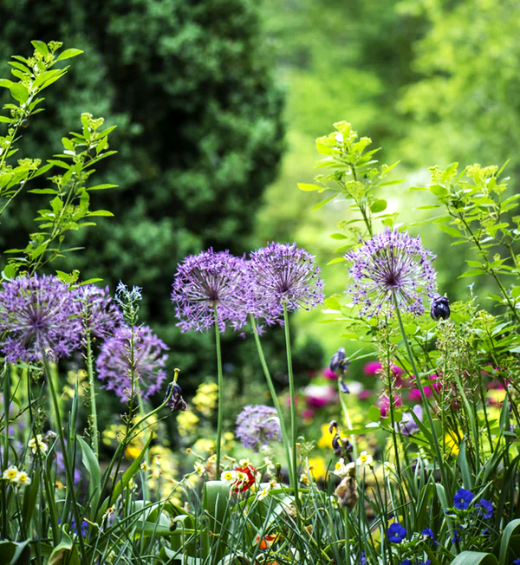
Plant Diversity
The number of different plant species is a lot higher in cities, as opposed to rural areas where monocropping is the most common
The increased diversity means there will be many different flowers throughout the growing season

Slide 19
“I pulled up to my hive about seven or eight. I filed into my hive with all of my mates.”

Slide 20
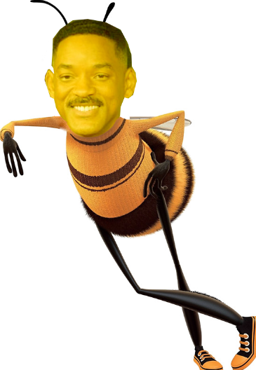
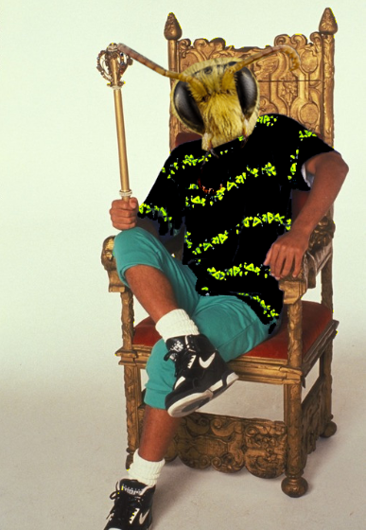
“Looked at my kingdom I was finally there. To sit on my throne as the queen of Bee-lair!”
Buzz Out!

Slide 21
References
https://commons.wikimedia.org/wiki/File:Bee_icon.png
Bee-swarm.jpg
https://unsplash.com/photos/Mkk_9x42Sbg
https://unsplash.com/photos/0ZxdAGG4aWU
https://www.edmonton.ca/city_government/initiatives_innovation/food_and_agriculture/beekeeping-pilot-project.aspx
For more information about urban beekeeping check out:

