Slide 1
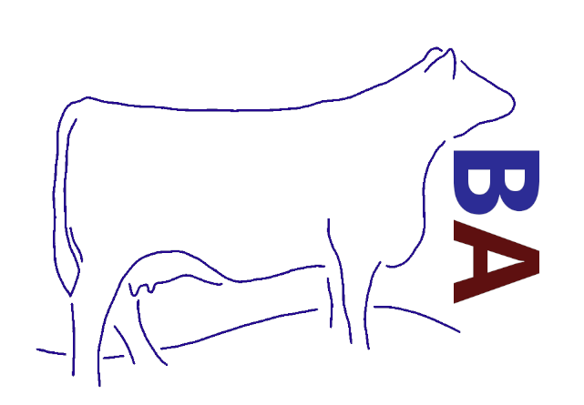
Bluestone Angus
Curtis Vos, Halley Adams, Stephanie Chang, Nolan Johnson, Cheuk Yin Lai, Ashley Lassu, Sierra Sayles, Carter Snethun, Kimberlee Ten, Morgan Williams, Julia Willock

Slide 2
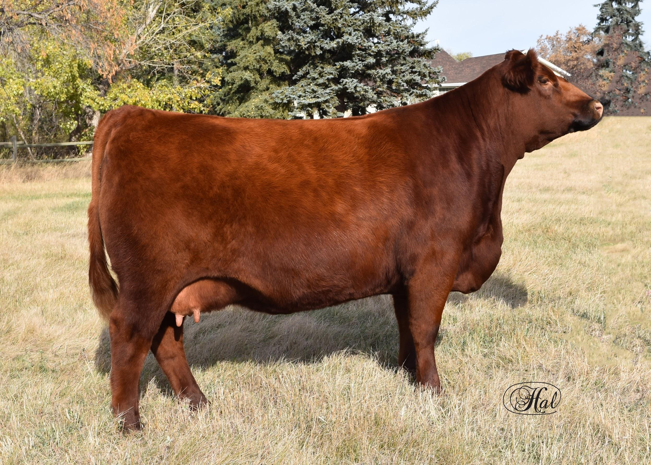
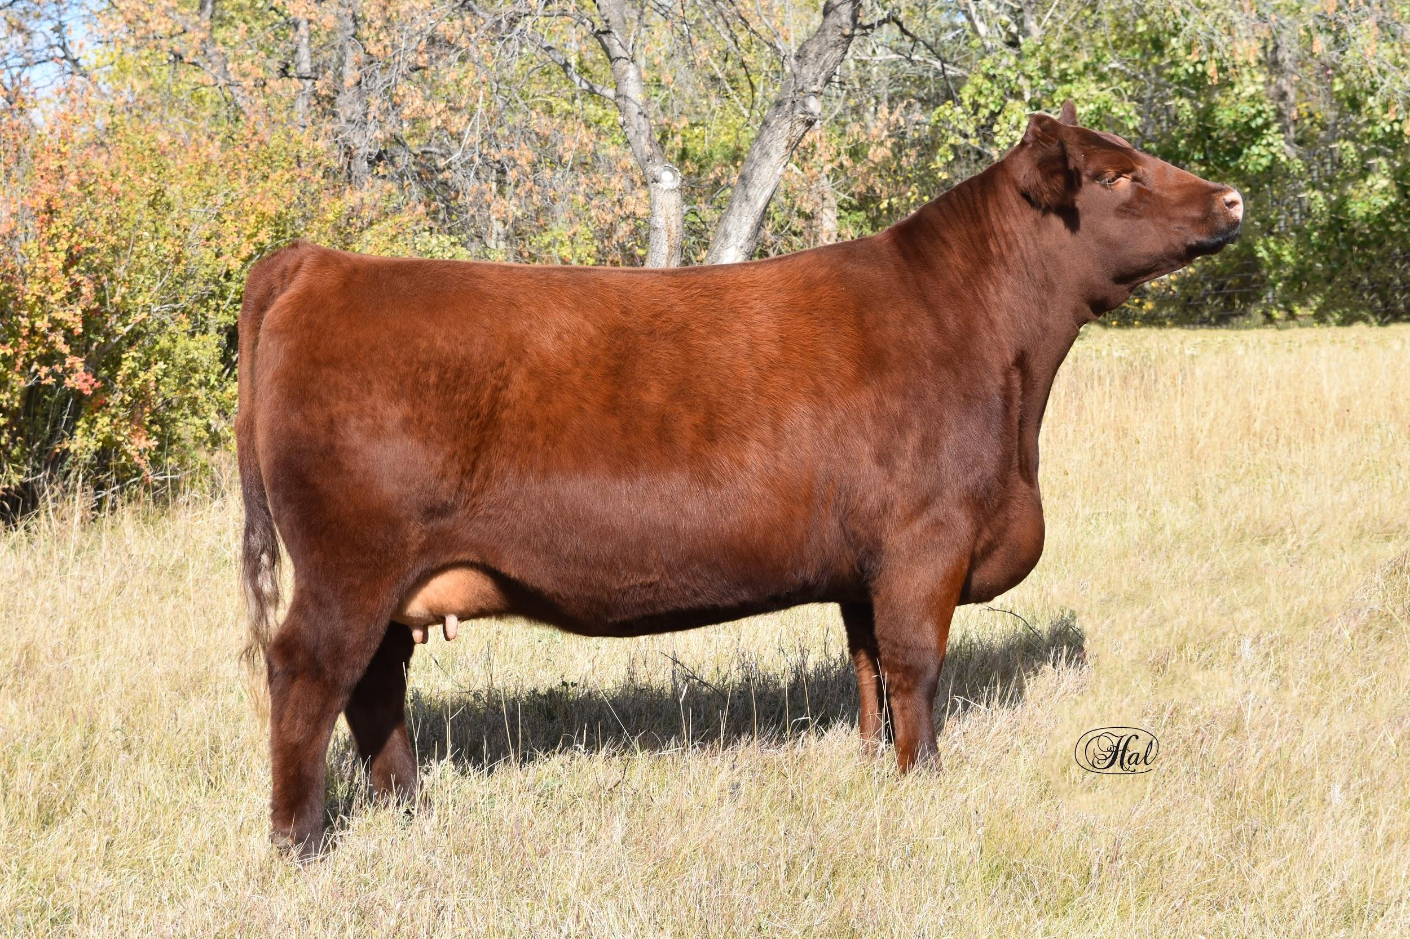
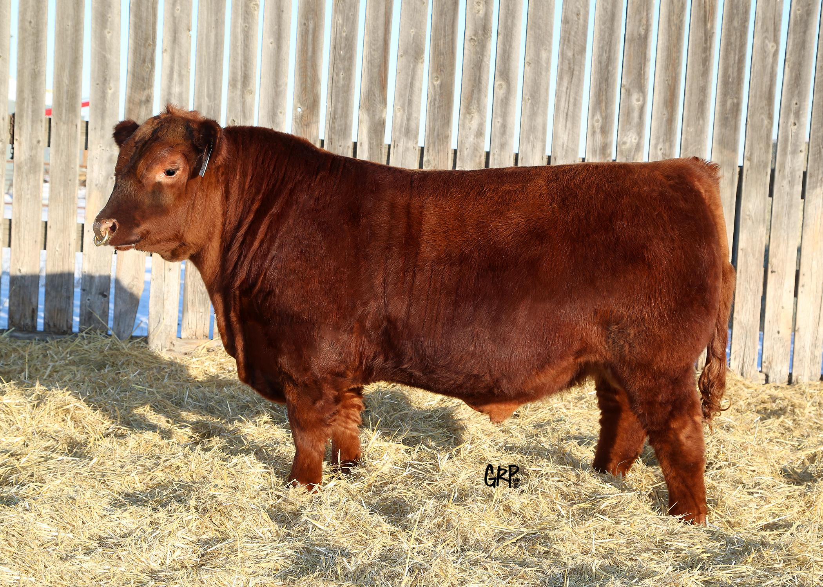
Our Farm
Here at Bluestone Angus we raise quality purebred Red Angus cattle with the commercial cattlemen in mind. Our focus is to raise well structured, functional, maternal and sound footed females, and easy fleshing, thick made breeding bulls. Our main focus is to sell our yearling bulls and select females in a spring sale.

Slide 3
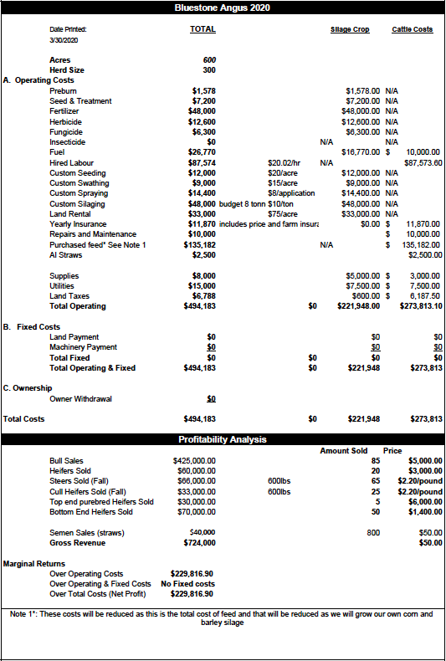
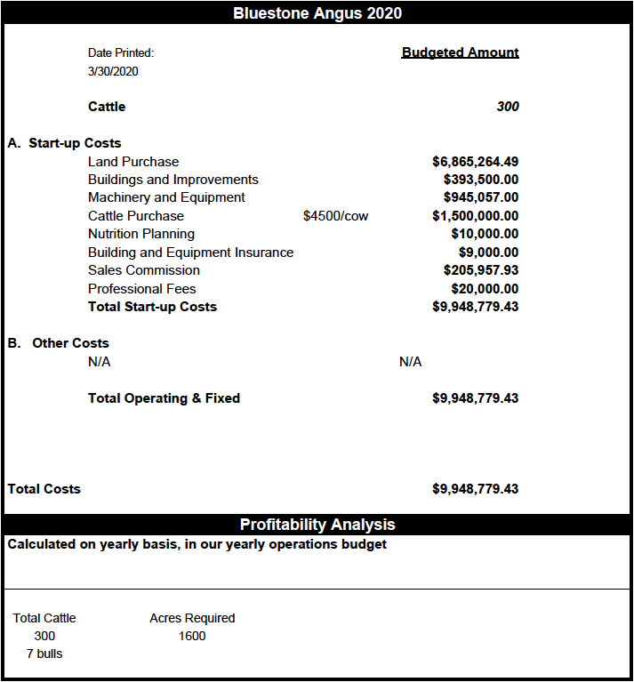
Our Financials

Slide 4
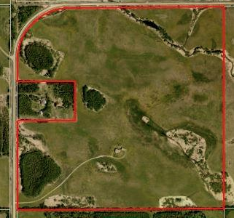
Our Land
51441 RGE RD 210,
Strathcona County, Alberta
146.23 acres
$574,900.00
Total Land:
1600 acres
$6,290,364.49
Notes:
The land we found is a 146.23 acre parcel selling for $574,900.00. We were unable to find any parcel of land larger than this, so we used this as a basis to purchase more land. We purchased 1600 acres at a price of $3931.48 per acre, totalling $6,290,364.49.

Slide 5
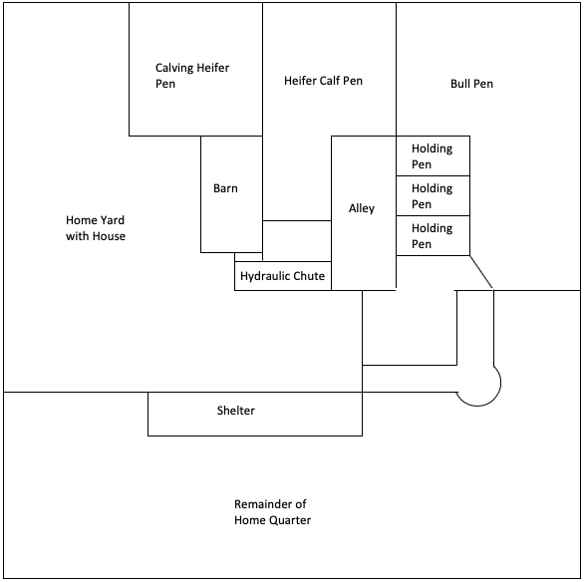
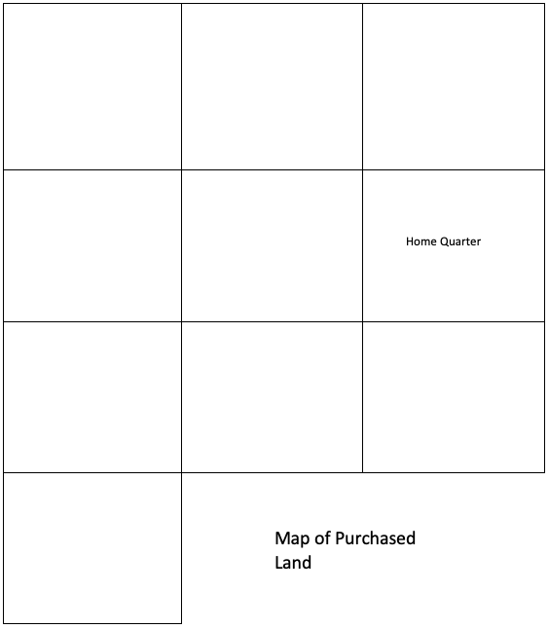
Our Layout

Slide 6
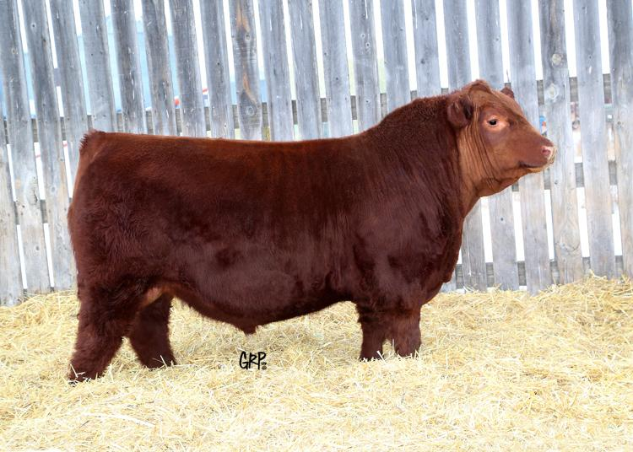
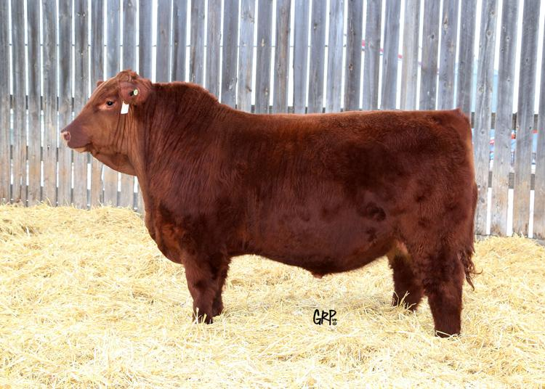
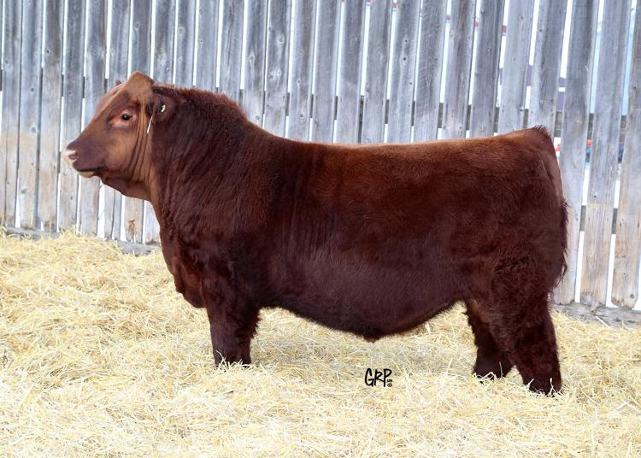
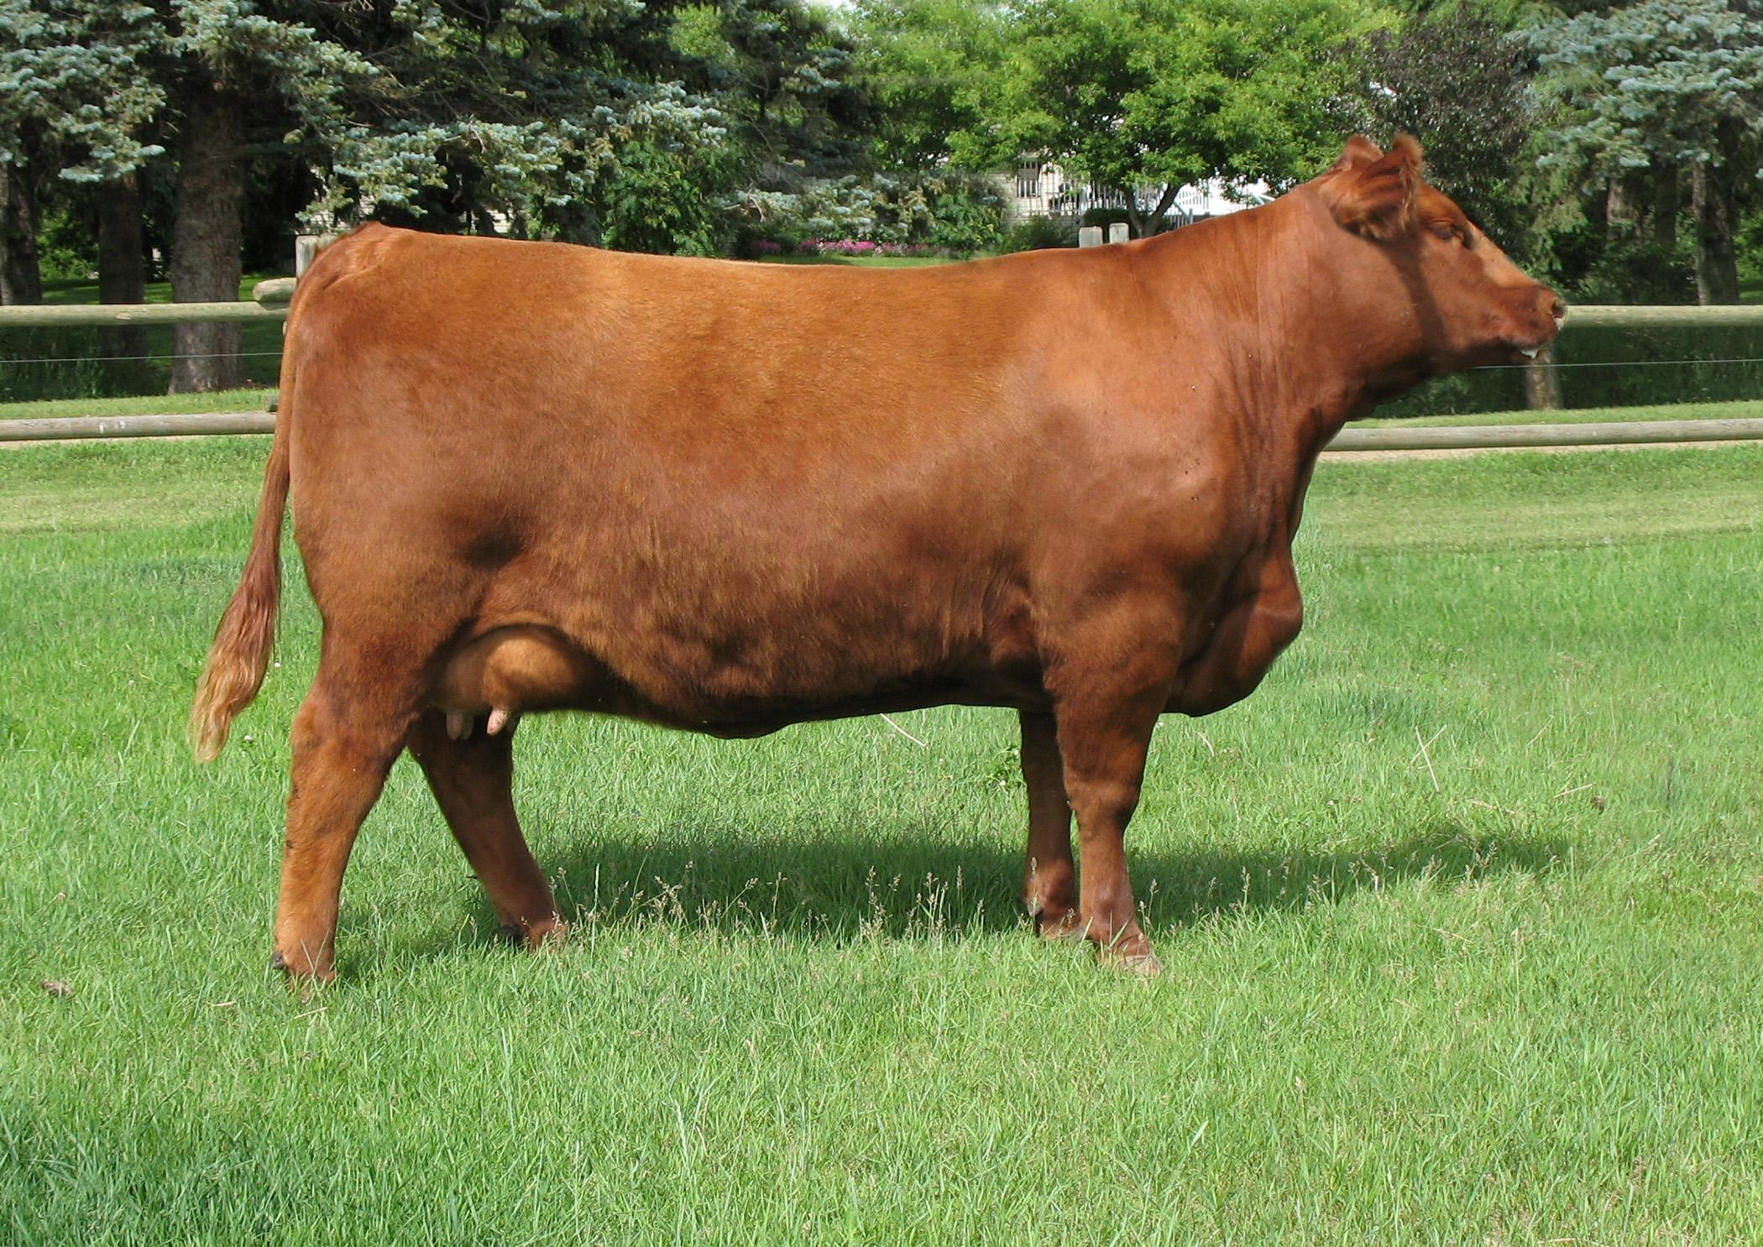
Our Cattle
300 purebred Red Angus cows
7 purebred Red Angus bulls
450 straws of high quality Red Angus semen

Slide 7
Bull Sale
On offer:
85 yearling bulls
20 yearling heifers
Third Thursday of March every year!!

Slide 8
Cattle Revenue
Cattle Revenue:
Bulls sold in sale: sale average = $5,000 → $5,000 x 85 bulls = $425,000
Heifers sold in sale: sale average $3,000 → $3,000 x 20 heifers = $60,000
Steers sold in fall: 65 head x $2.20 (average weight 600 lbs) = $85,800
Cull heifer calves sold in fall: 25 head x $2.20 (average weight 600 lbs) = $33,000
Top end purebred heifers: 5 head x average $6,000 = $30,000
Bottom end heifer calves sold commercially: 50 head x $1,400 = $70,000
Total Revenue: $703,800
Semen Sales:
Semen will sell in packages of 10 at $50/straw:
200 straws from 4 select herdsires x $50 = $40,000
Total Semen Sales: $40,000

Slide 9
Feed and Nutrition
Total mixed ration
Corn silage, cereal premix, pea grain, and barley straw
Salt and mineral mixture available ad-libitum
Total first year cost of feed for 300 cows and 7 bulls: $135 182
Corn silaging process
Corn is a high energy food source with low crude protein and calcium
We will rent land to grow our own corn - low cost and hardiness
Harvest at 60-70% moisture
Fermentation for at least 3-4 months before serving
Water
Constant and unlimited water supply for all cattle at all times
In the winter, mature cows drink 22-47 L of water per day

Slide 10
Animal Health - Veterinary services
Main Goals:
Herd Health
Pregnancy Checks
Artificial Insemination
Surgery and Wound Control
Disease Prevention - Vaccinations / Medications
Euthanasia
Our main goal at Bluestone Angus is to provide high quality, healthy animals within the cattle industry. Maintaining herd health and constantly providing the best genetics will allow our cattle company to succeed.

Slide 11
Risk Management
Price insurance purchased through WLPIP - $2,800 to lock in floor price of $210/cwt.
Farm insurance purchased through Co-Operators. New quotes unavailable due to COVID-19. Estimated price ~$9,000/yr.
Total cost of insurance ~$11,870/yr.

