Slide 1
Big Gainz Cattle Co.
Please Visit Our Website!
https://biggainzcattle.wixsite.com/mysite-1
Allaric P., Alyssa H., Brandon W., Carson N., Cauy L., Chris D., Cindy Y., Colton L., Jonathan E., Kassi A., Mikayla E., Tamryn S., Tyson M.

Slide 2
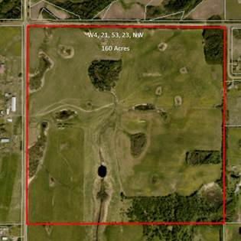
Real Estate
Purchased 160 acres of land:
Found in Strathcona County (TWP 534, RR 212)
Cost: $1,100,000
Power and gas accessible from the road
Falls under the small holdings policy which is intended to allow opportunities for agricultural businesses such as our feedlot
Drilled industrial sized well:
While power and gas were supplied from the road, getting water to the feedlot was an issue
Quoted: $15,300 through Radco Drilling

Slide 3
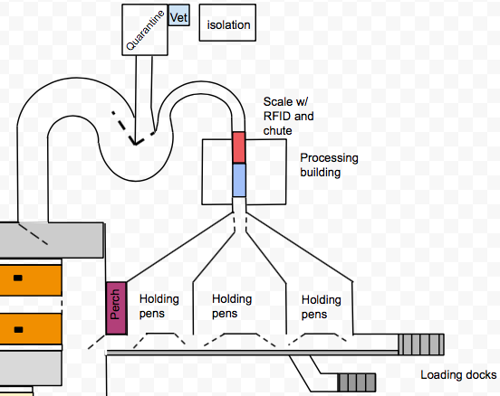
Infrastructure
Priced out larger investments such as a feed mill, silage pits, heated shop, headquarters building and, equipment cold storage
Designed a feedlot capable of handling 10 000 head of cattle comfortably with room for expansion or overflow
Followed NFACC guidelines for pen and feed bunk dimensions: 250 ft² of pen space per head and 1 ft of feed bunk space per head
Processing design is inspired by the work of Temple Grandin, with the ability for dual direction of travel for shipping and receiving cattle.
Crowding tub is capable of sorting out at risk cattle or sick cattle and placed into a quarantine pen
Each holding pen is capable of holding a truckload worth of cattle at a time
Big Gainz Cattle Co. processing design

Slide 4
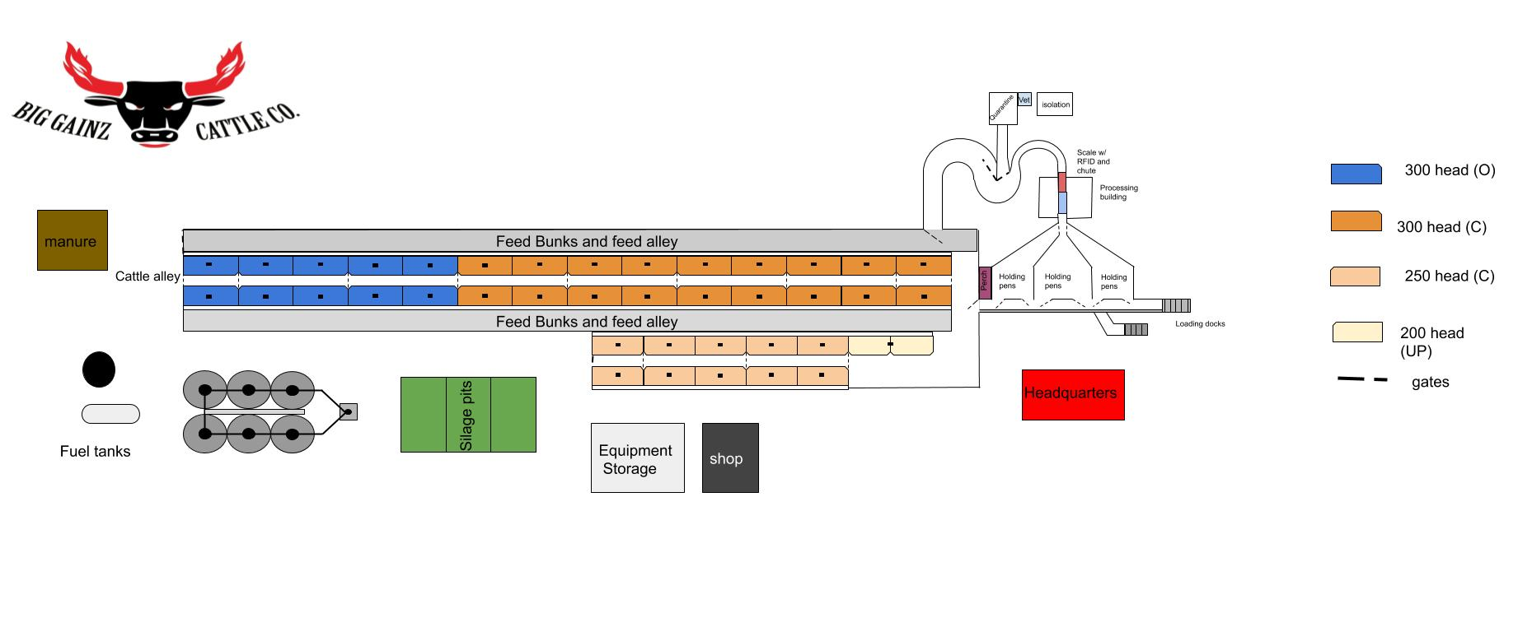

Slide 5
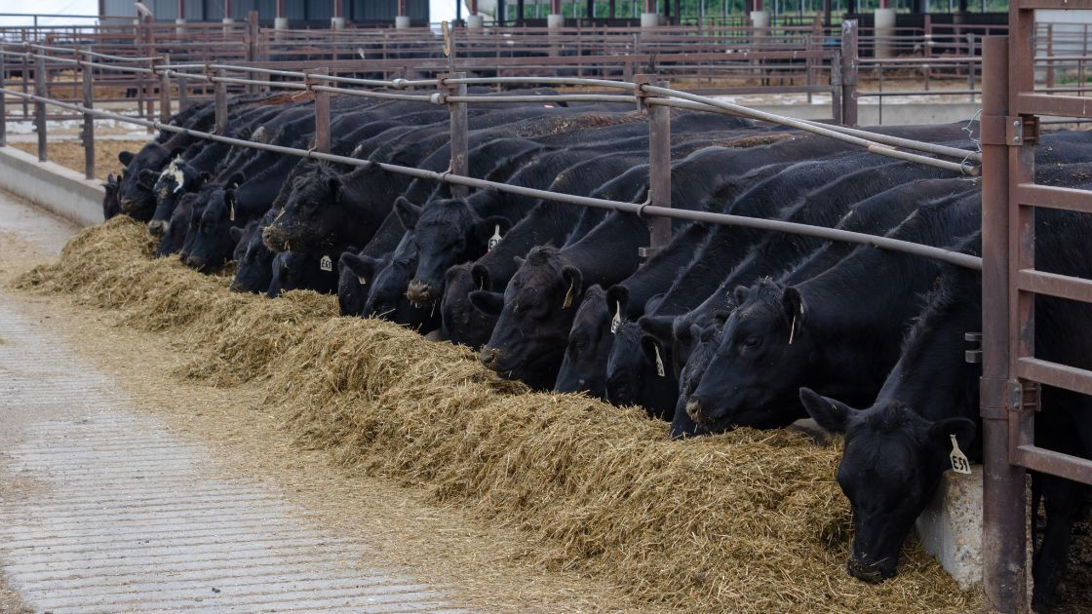
Cattle Manager
Purchase angus/simmental cross calves to provide hybrid vigour.
Estimated costs for purchasing 3000 head.
Provided a feed pricing system for custom fed cattle.
Estimated revenue for sold cattle.
Calculated days needed to finish cattle and determined annual capacity of the feedlot.
Researched requirements needed to attain the certified angus beef brand.

Slide 6
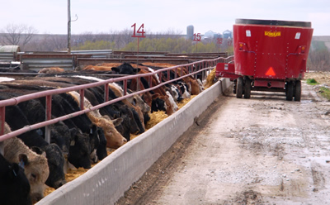
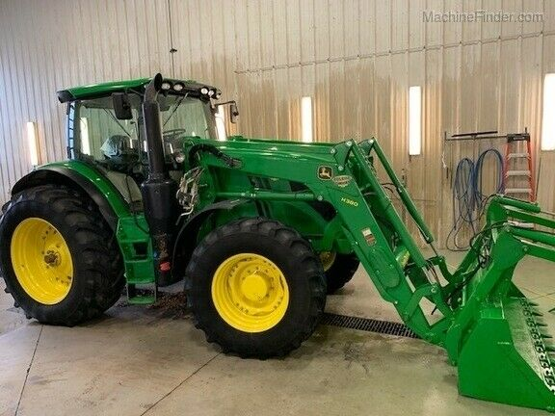
Equipment Manager
Purchased Equipment needed to operate a feedlot.
Ensured the equipment purchased was focused of efficiency and operator comfort.
Compared each piece of equipment to ensure we got the best deal.
Estimated the annual maintenance cost for the equipment.
Purchased efficient cattle handling equipment, with cattle comfort in mind.

Slide 7
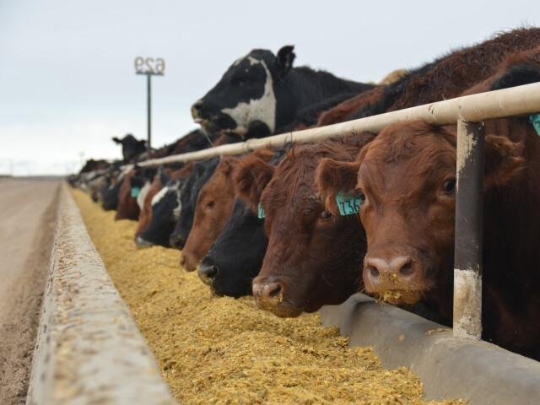
Nutritionist Feed Manager
Formulated 9 Rations to best suit the needs of the cattle
Worked with feed manager to source feed components
Found and researched the best vitamins, minerals, and concentrates to add to feed to maximize ADG and profit
Worked with the nutritionist and cattle buyer to create and provide the proper ration sizes for our cattle.
Created a feeding calendar consisting of 9 cycles, each with their respective daily ration size based on cattle weight.
Used the feeding calendar to total up and buy all required feed for the year.
Researched and totaled extra trucking costs for our feed to be hauled.

Slide 8
Veterinarian Biosecurity
Created an initial processing protocol to complete when cattle enter the feedlot
Includes: RFID verification, new ear tag, weigh in, inserting implants, vaccination, deworming, and potential castration, pen location
Developed herd health management program:
3 stage daily pen check inspection
Surveillance of 9 most common diseases found in cattle and feedlots
Implement sanitation practices
Provide coveralls, boots, disposable gloves, designate equipment to specific jobs, vehicle washdown area, routine cleaning and disinfection of facilities, equipment, clothing, vehicles
Traffic control
Signs at access points, records of movement of people, animals, equipment on and off site
Herd health management in collaboration with veterinarian
Educate and train personnel on biosecurity program

Slide 9
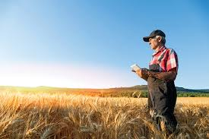
Insurance/Risk Manager Labor Manager
Purchased AgriStability Insurance from Agriculture Financial Services Corporation (AFSC):
Provides overall financial loss insurance for our feedlot. Covers financial loss in regards to the equipment, buildings, cattle/herd and farm processes.
Purchased Workers Compensation Insurance:
Provides wage replacement and medical benefit insurance for our employees in the case of an injury while working.
Farm Risk Management:
Implemented safety precautions and procedures in order to reduce risks relating to herd health, employee safety and knowledge, supply/feed regulation and equipment management associated with our feedlot operation.
10 labourers employed (1 per ~1000 head):
Each employee will be trained to perform all duties required involving in Animal Handling, Maintenance, Animal Feeding, Receiving and Outgoing.
Regular 40 hour work weeks.
Wage Rate is $25/hr.
Employer-Employee Contract drawn up.
Each employee will work for 5 days (8 hours each) and have 2 days off, not necessarily following the typical week-weekend schedule.

Slide 10
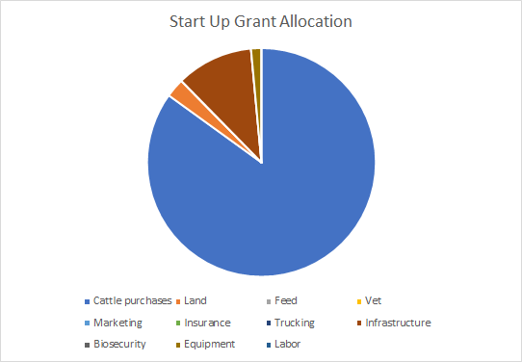
Finances
Used data from the group spreadsheet to predict feedlots expenses and profit for first year
Categorized expenses by start up and annual costs to ensure proper cost tracking
Ensured we stayed on budget by setting up spreadsheet calculations which allowed all members to track and monitor progress
Total start up costs: $9,994,479.49
Total Estimated Expenses (year one): $17,925,423.82
Total Estimated Revenue (year one): $18,556,615.50
Total Estimated Profit (year one) : $631,191.68

