Slide 1
Owned and operated by: Stefan Lundberg, Bailey Hartwig, Brett Sauder, Rachel Chan and Leah Trenson

Slide 2
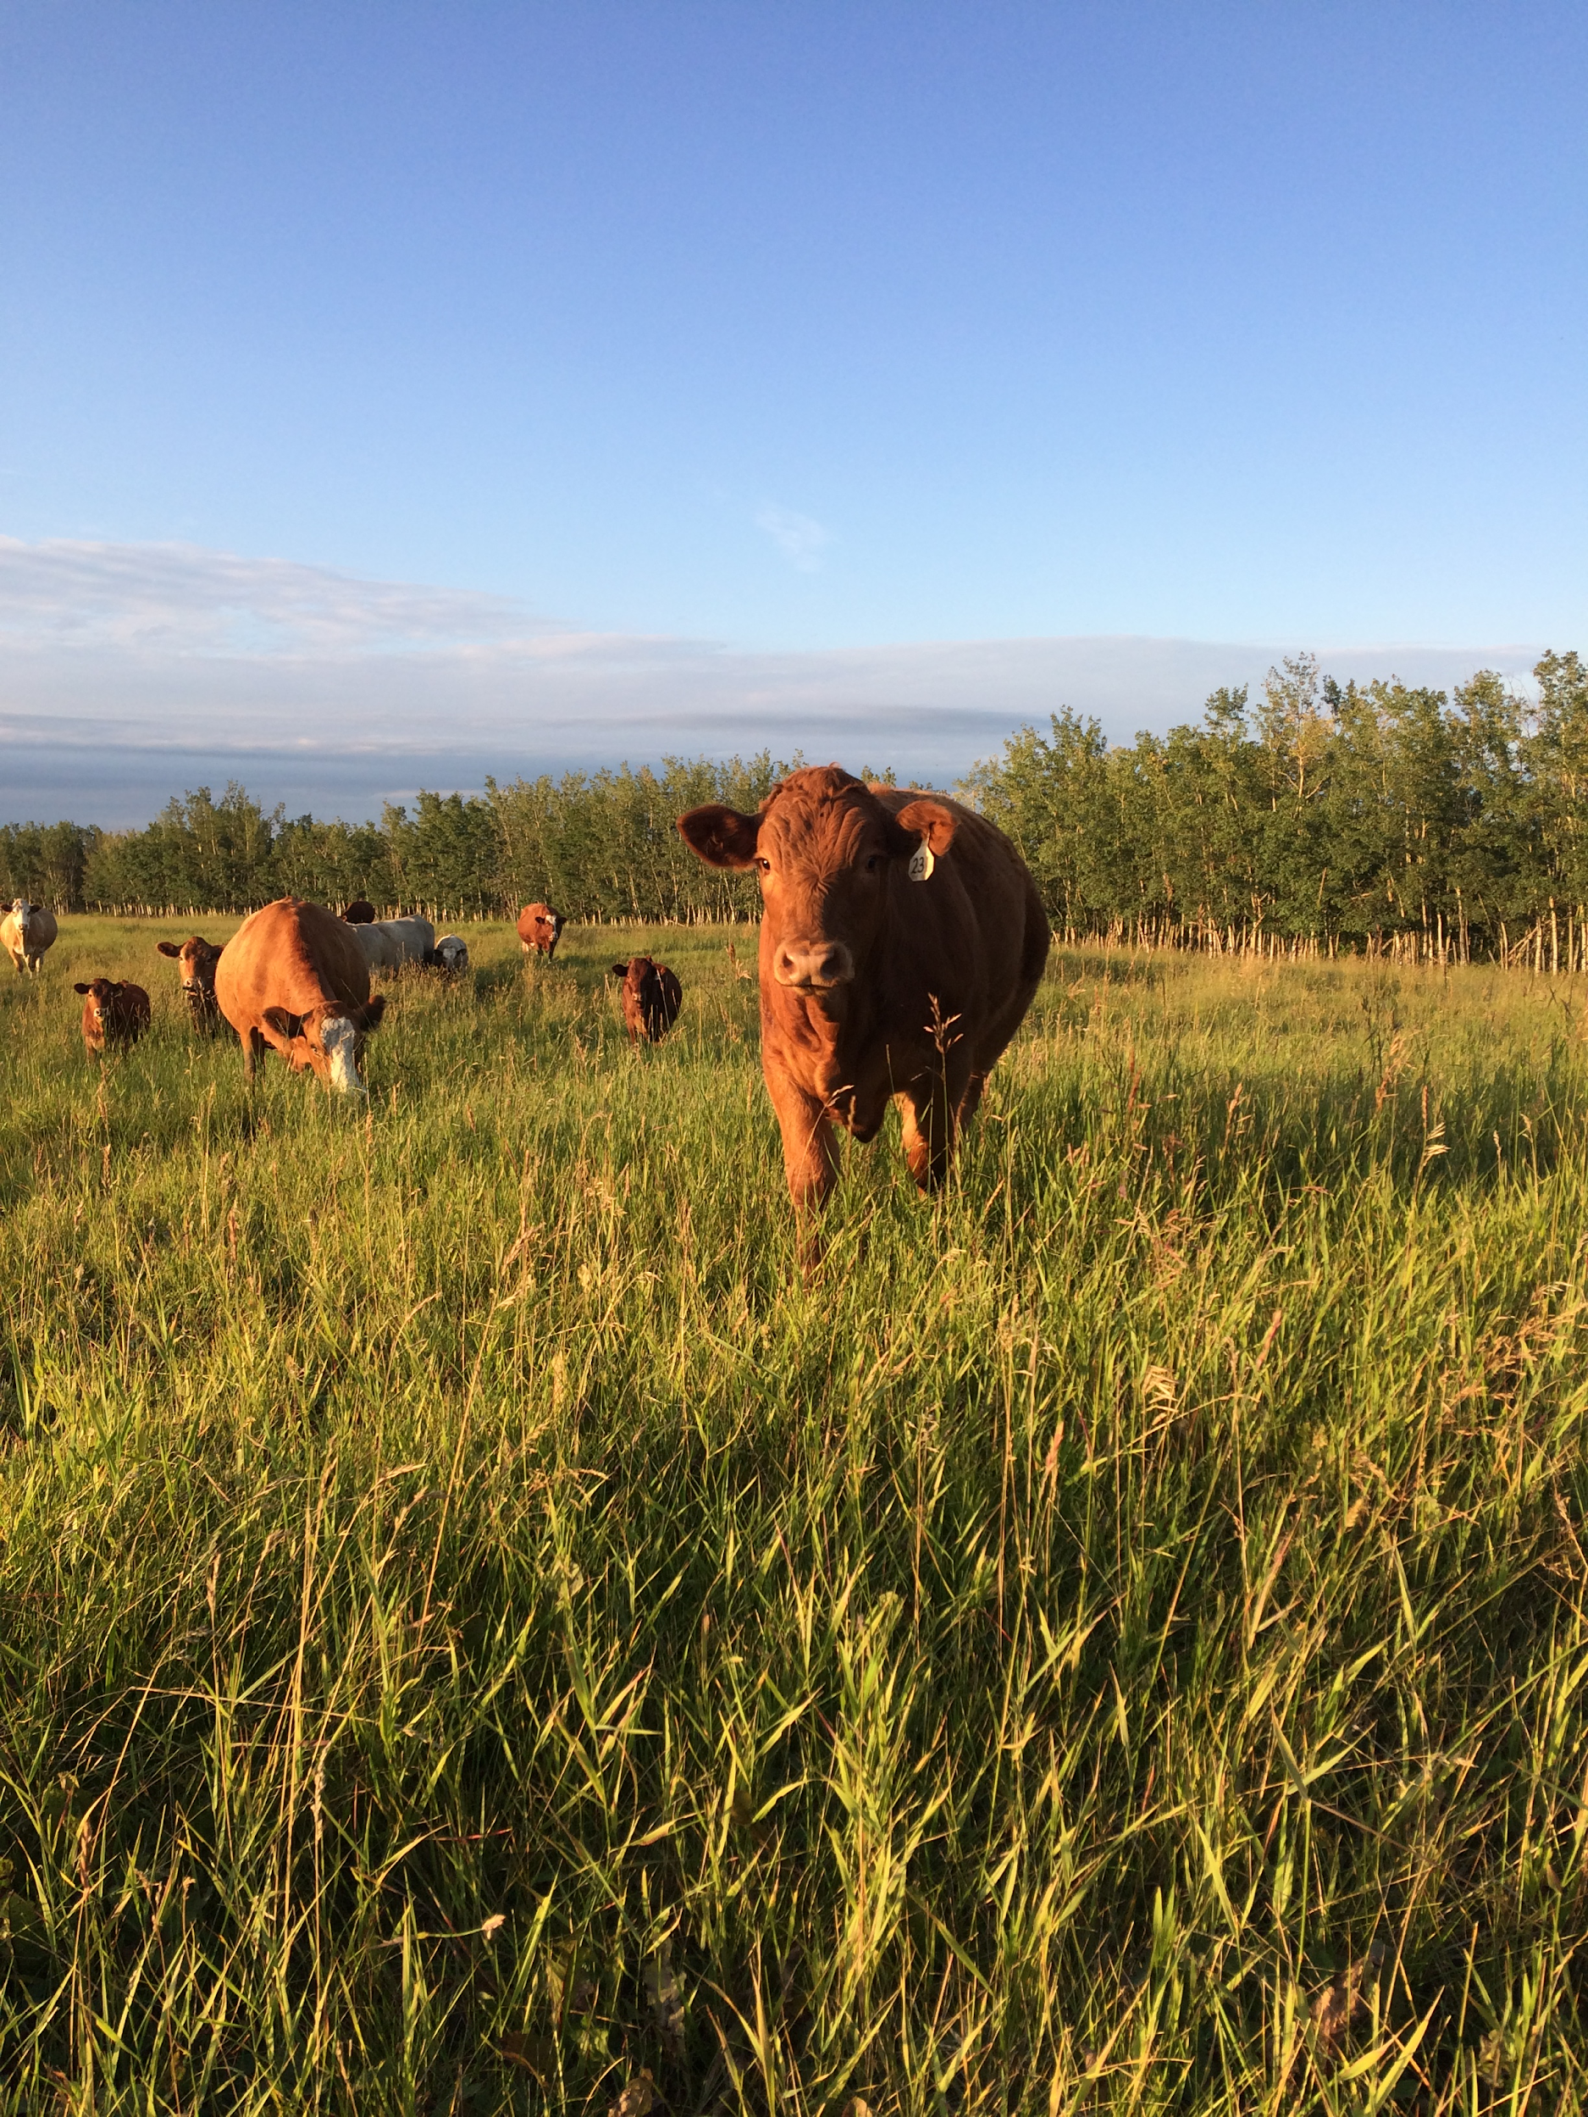
Breeding Stock
400 Simmental/ Red Angus cow calf pairs
Calve in the spring with heifers starting two weeks earlier than cows
Natural Breeding
Traits we are selecting for:
Good feet and legs
Calving Ease
Good Udders
Strong muscling
Docile temperament
Polled

Slide 3
Marketing
Satellite Auctions
Used for marketing steer calves in the fall
Local Auction Market
Used to sell smaller groups such as open and cull cows as well as yearling non- replacement heifers
Verified Beef Producers
Validates responsible production practices
Alberta Open Farm Days
A major focus of our farm is to provide information to consumers as to how food reaches their plate
Notes:
Image: http://verifiedbeefproductionplus.ca/

Slide 4
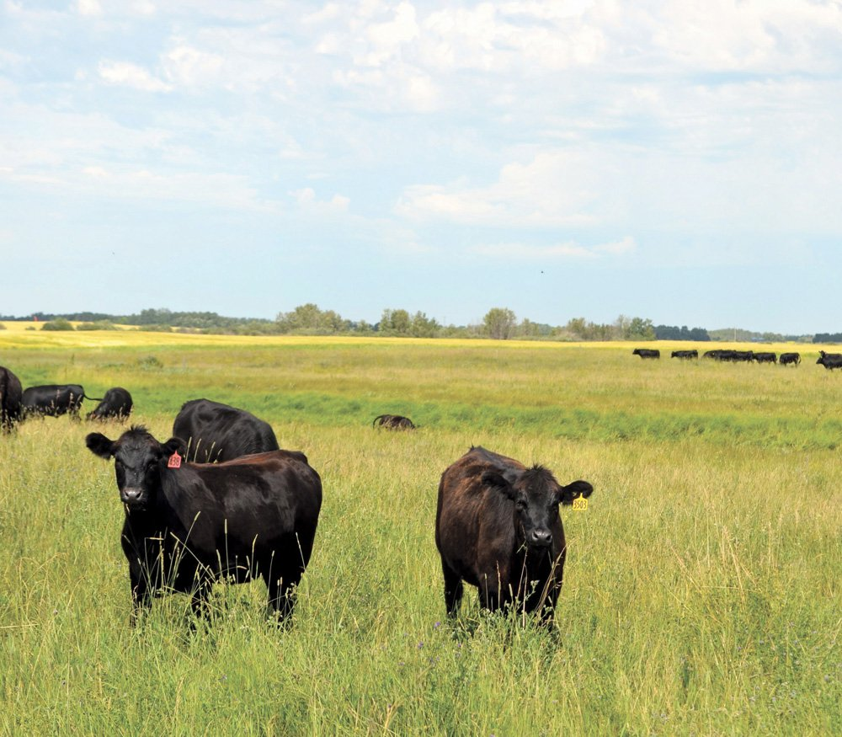
Nutrition and Feeding
On our 758 acre farm, we will grow 755 acres of Alfalfa and Meadowbrome; 300 acres for hay and 455 acres for silage. From our land we will be able to grow enough forage to feed our herd for 6 months of the year.
For the remaining 6 months of the year, we will send our herd to graze on community pasture.
In order to ensure that we are meeting the nutritional needs of our cattle, we will send our forages for feed testing and then provide a mineral based on our findings.
Image: https://www.google.com/search?q=community+pasture
Notes:
-We will send samples to be tested at Parkland Laboratories to ensure that nutritional requirements are being met, and then provide dry mineral as necessary
-for water, we will use insulated water troughs to ensure there is always fresh, liquid water available to our cows. We will need 4 of these troughs, as each one is able to accomodate water for ~100 head.
-In order to transport the herd to graze on community pasture, we will hire a trucking company - Westland Livestock Inc.

Slide 5
Labour
We will have 6 people working on our farm, the 5 of us and one seasonal hire for feeding during the winter.
During calving season, we will run alternating night and day shifts so that there is someone available for calving assistance at all times.
Each staff member will have two to-do lists; a list of daily duties and a list of larger tasks to be completed throughout each season.
Notes:
-We will each be paid a salary of $30,000/year

Slide 6
Health & Biosecurity
Vaccination (Bovi-Shield Gold IBR-BVD)
CCIA Tags, Manifests
Have PPE (Personal protective equipment)
Disposal of dead animals
Sanitation (Boot covers, hand sanitizer stations)
Daily checking for health
Cleanliness level of calving grounds

Slide 7
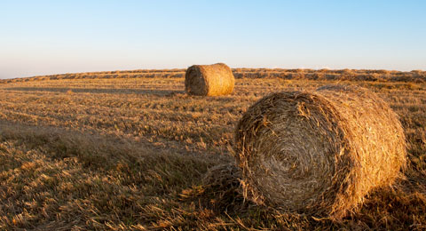
Land Buying
1258 acres bought 20 minutes away from Edmonton
Prime agricultural land in a good soil zone
We have also secured a 1000 acre grazing lease on crown land that will be enough for most of the cattle to graze throughout the summer
The remaining land will be for silage to supplement feed requirements

Slide 8
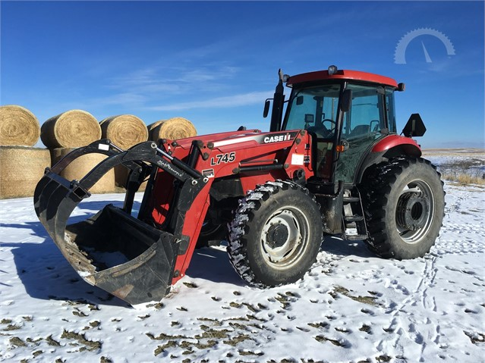
Equipment Buying
Tractor for feeding and general purpose use
Bale unroller for feed and bedding
Feed truck to spread silage in winter
Two trucks for hauling and general business
ATVs for herding, Maintenance, Ect
Various other equipment to ensure a smooth operation

Slide 9
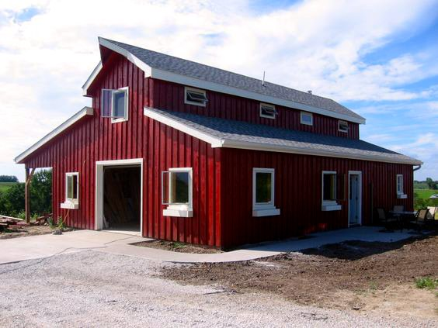
Buildings
Already existing shop on Land
New barn for housing, calving, ect
Handling facility for loading, vaccinations, branding, sorting and weighing
Fences around the perimeter of each quarter
Temporary electric fences for separating each quarter further

