Slide 1
KNOW YOUR NEIGHBOUR Purpose: This education model strives to provide streamlined information for people currently living or moving out to acreages ensuring both a level of biosecurity and knowledge about surrounding neighbours and the potential implications of disease transmission to provide safer environment for all involved. Focus: This education model is a website that will break down into five key elements: “Know traceability”- Understanding PID and common questions around it. “Know the animals” - Listing all the potential livestock and animal husbandry associated with the animals in that area. “Know the disease transmission”- List common diseases, routes of transmission. “Know prevention”- List necessary vaccines, sanitation, decontamination. “Know your contacts”- Veterinarian, Nutritionist, Surrounding farms and other livestock facilities. Overall: This education model aims to provide a sense of community, health and a source of “checklist” items that ensure safety for livestock and farms everywhere. Within the 4 main points ideally, we will provide insightful checklists and links to the government of Canada websites and articles for further readings or more advanced information. The goal is to create a steppingstone in trying to achieve a base layer of information and highlight one health to show how interconnected the community is with livestock and small farm operations. We believe this project will advocate for how safe and practical measures create a well conditioned community and provide well-being on all fronts.

Slide 2
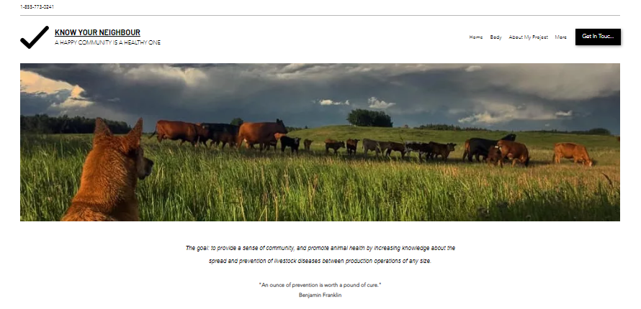
ANSC 101: AG FEST PRODCUTION
Education Model:
Website: KNOW YOUR NEIGHBOUR
https://klain0.wixsite.com/knowyourneighbour
Megan Klain &
Mienna Starosielski
The goal: to provide a sense of community, and promote animal health by increasing knowledge about the spread and prevention of livestock diseases between production operations of any size.
"An ounce of prevention is worth a pound of cure."
Benjamin Franklin

Slide 3
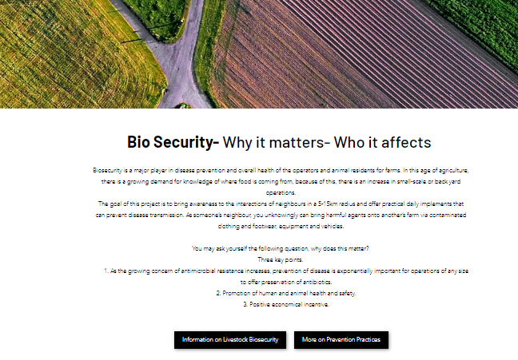
Biosecurity is a major player in disease prevention and overall health of the operators and animal residents for farms. In this age of agriculture, there is a growing demand for knowledge of where food is coming from, because of this, there is an increase in small-scale or back yard operations.
The goal of this project is to bring awareness to the interactions of neighbours in a 5-15km radius and offer practical daily implements that can prevent disease transmission. As someone’s neighbour, you unknowingly can bring harmful agents onto another’s farm via contaminated clothing and footwear, equipment and vehicles.
You may ask yourself the following question, why does this matter?
Three key points.
As the growing concern of antimicrobial resistance increases, prevention of disease is exponentially important for operations of any size to offer preservation of antibiotics.
Promotion of human and animal health and safety.
Positive economical incentive.

Slide 4
Know Traceability
Know the Animals
Know Prevention
Know Disease Transmission
Know your contacts

Slide 5
Before purchasing livestock and/or poultry ensure you have planned ahead. Premises Identification (PID), as one of the pillars of traceability, ensures that livestock and poultry have identifiable links to land locations and premises. Information within the PID system can be accessed for the protection of the livestock and poultry industries. The PID system has a variety of uses which include planning for, controlling, and preventing the transmission of animal disease. The identification program is also used to notify animal owners of impending emergencies that could affect their animals. By completing a PID application and keeping your information up-to-date, you will not only take an important step in protecting your own animals, but those of other Alberta and Canadian producers as well.

Slide 6
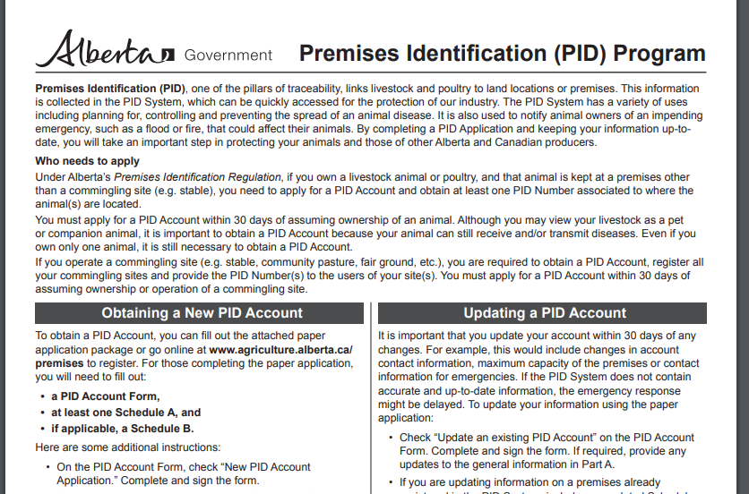
Website links for Traceability

Slide 7
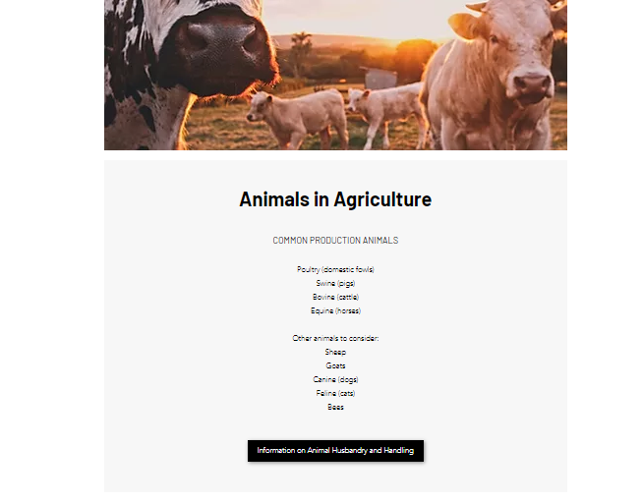
COMMON PRODUCTION ANIMALS
Poultry (domestic fowls)
Swine (pigs)
Bovine (cattle)
Equine (horses)
Other animals to consider:
Sheep
Goats
Canine (dogs)
Feline (cats)
Bees

Slide 8
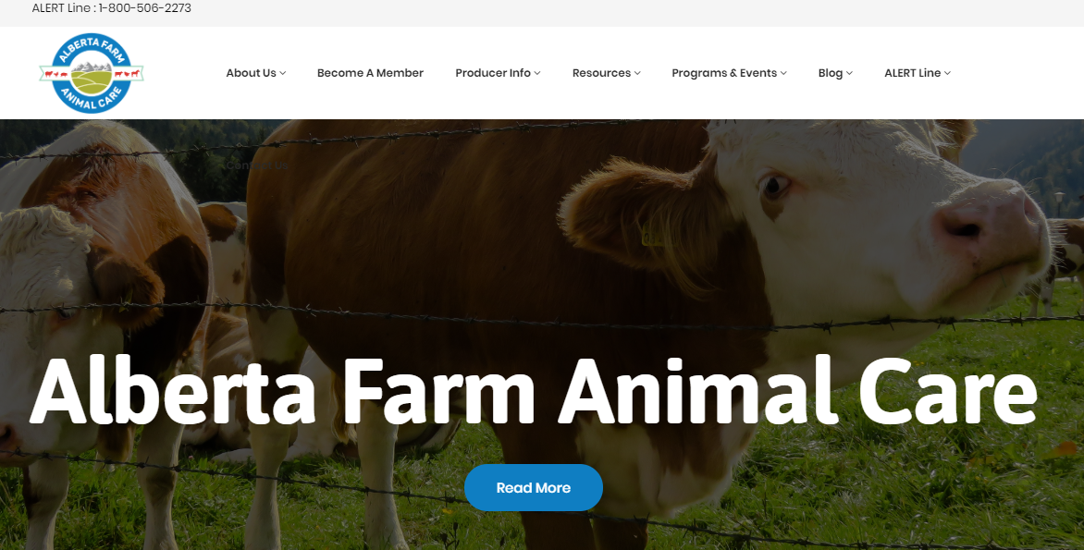
Website link for Animals in Agriculture

Slide 10
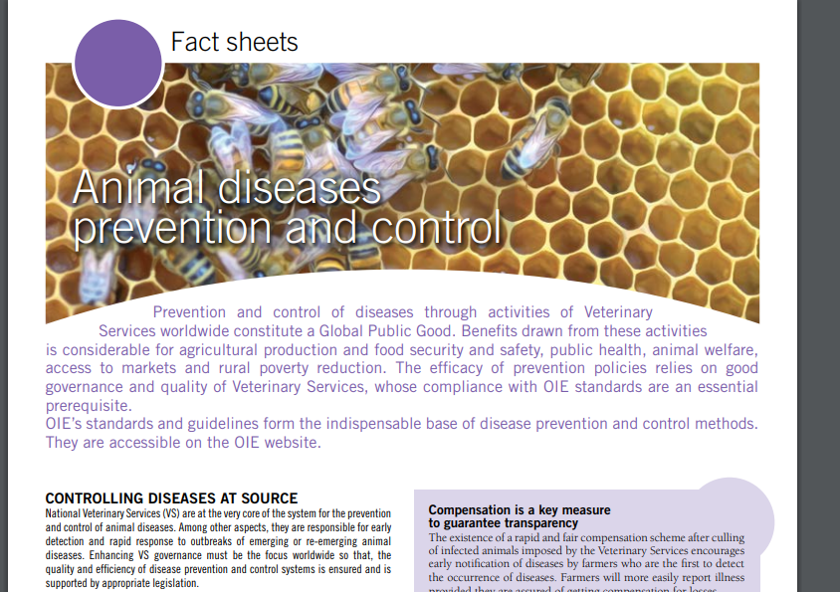
Website links for Disease Prevention

Slide 12
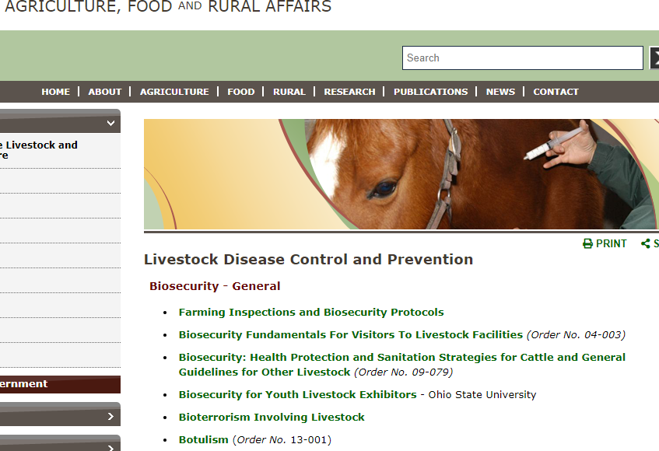
Website link for Disease Transmission

Slide 13
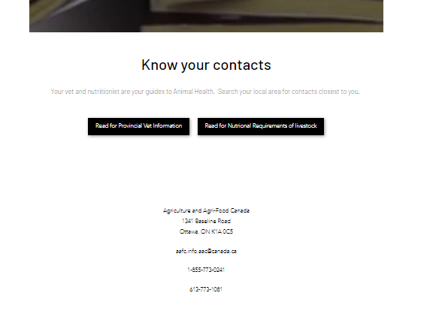

Slide 14
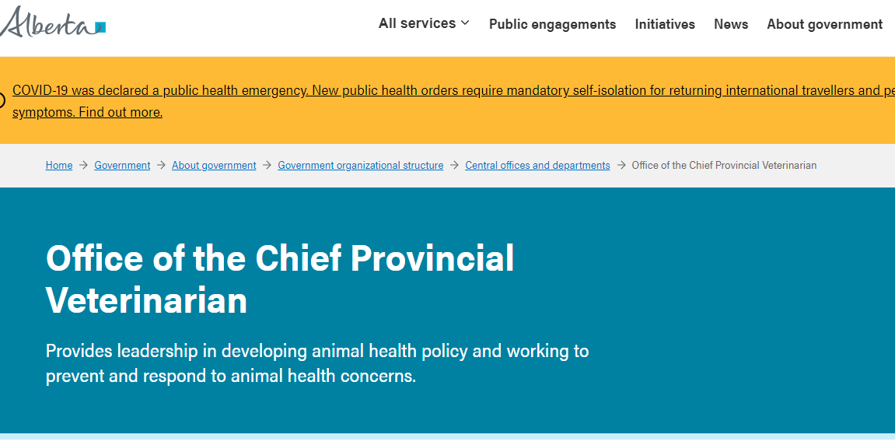
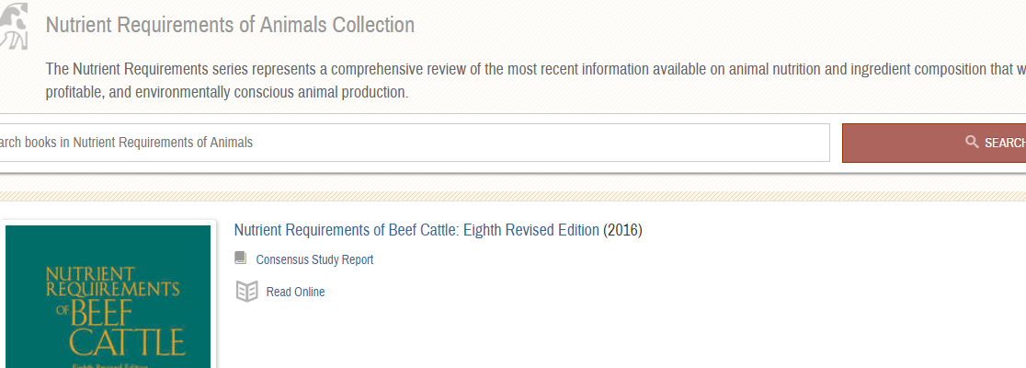
Website links for contacts to know

Slide 15
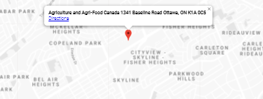
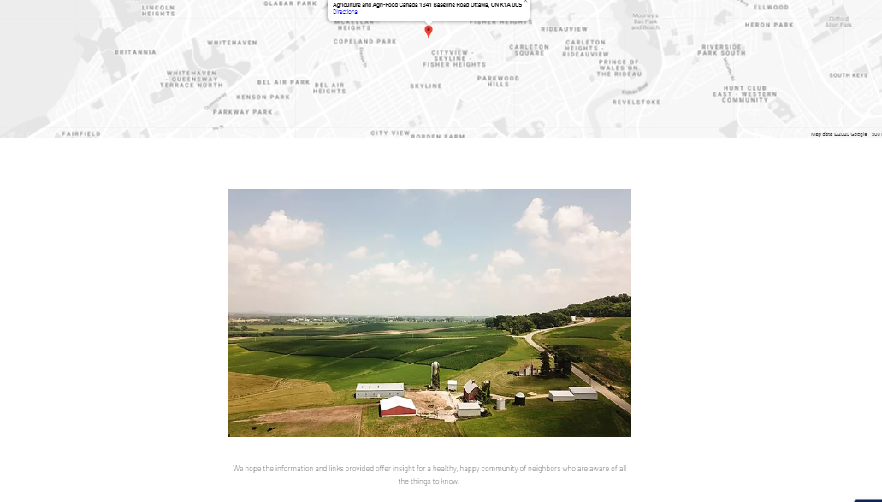
We hope the information and links provided offer insight for a healthy, happy community of neighbors who are aware of all the things to know.
https://klain0.wixsite.com/knowyourneighbour

