Slide 1
Should we go ‘Beyond’ Beef?
Sustainability of Plant Based Beyond Meat Burger versus Beef Burger
By: Chantel Unruh, Phoenix Irwin, Jordyn Sands, Yvonne Zhou, Chido Saunyama

Slide 2
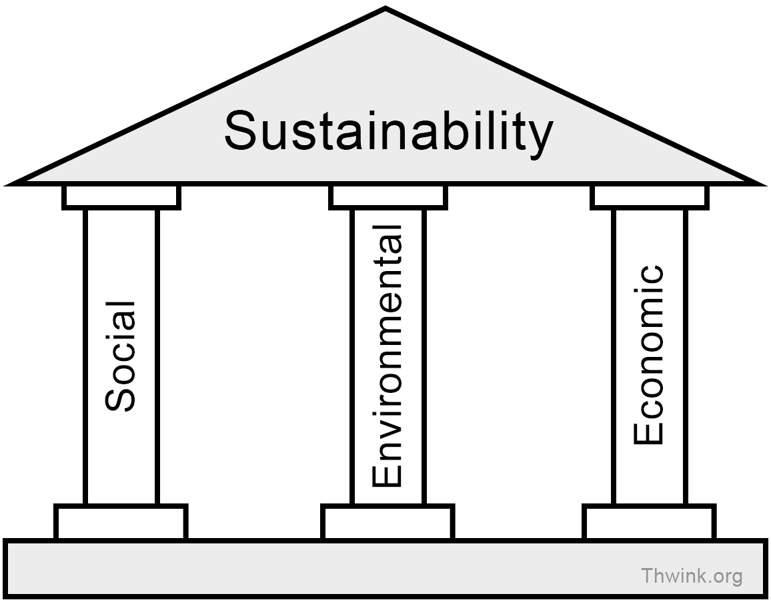
Defining Sustainability
Three Pillars of Sustainability
People - Society
Planet - Environment
Profit - Economy
https://www.thwink.org/sustain/glossary/ThreePillarsOfSustainability.htm

Slide 3
People
Population Growth -
The global population has rapidly increased, creating a problem of food security.
Reliance on meat protein sources alone to accomodate to the growing demand of the population is unsustainable both economically and environmentally.
Introduction of plant-based meats offers consumers alternatives and increases food supply.
Cost to people -
Beyond Meat is more expensive due to the increased cost in labour wise and technology.
Age -
The increase in education about animal welfare and the environmental impacts of animal agriculture in school curricula has resulted in the younger generations driving the demand for the Beyond meat products.
Geographic Distribution (location) -
The demand for vegetarian products is increasing in emerging countries - mainly countries in Asia and South America.
Europe and North America are the largest regions contributing to the growth of the plant based meat.

Slide 4
People
https://www.beyondmeat.com/about/
Nutrition -
Beyond meat:
longer longevity
lower risk of chronic disease
Real meat:
higher risk of premature death
Both Beyond Meat and beef burgers have similar calorie values. However beef burgers have higher amounts of unsaturated fats which are known to cause heart related health issues.
Environmental Impact -
Food proteins from plant sources are of interest because of their nutritional value and their eco-friendly carbon footprint.
Research and technological Development -
The plant-based meat market is expected to grow by 15% between 2019 and 2025.
Advances in research and development have resulted in products with better aromas, texture, nutritive value, and longer shelf life which makes plant based alternatives more appealing to consumers.

Slide 5
People - Summary
Accessibility: The high input costs such as technology, raw materials, and human capital required to make the Beyond Meat burger, makes it less accessible to the global population. Not all countries have the resources needed to produce Beyond Meat burgers yet. Beef is more readily available to the global population and input resources are more widely distributed. In terms of mitigating food insecurity, beef burgers are more sustainable than Beyond Meat burger because they are more accessible to the growing population.
Acceptability: With increased concerns about animal welfare and support from younger people in particular, in the long run the Beyond Meat burger could be more sustainable. The more widely accepted it becomes, supply will increase and prices will likely fall.

Slide 6
People - Summary
Health: The Beyond meat and beef burger patty have slightly different calorie, fat, and cholesterol contents. It is up to the consumer to decide which product is more sustainable healthwise, depending on the nutritional component they are most concerned about.
Cost: Beyond meat burgers are more expensive than beef burgers. In terms of economic feasibility, beef burgers are more sustainable for consumers.
Beyond Meat Nutrition Facts. https://www.beyondmeat.com/products/the-beyond-burger/

Slide 7
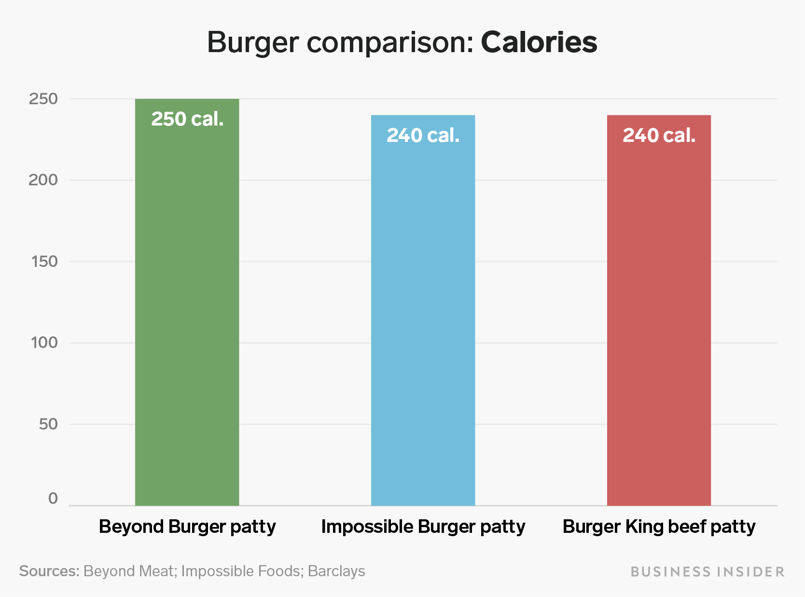
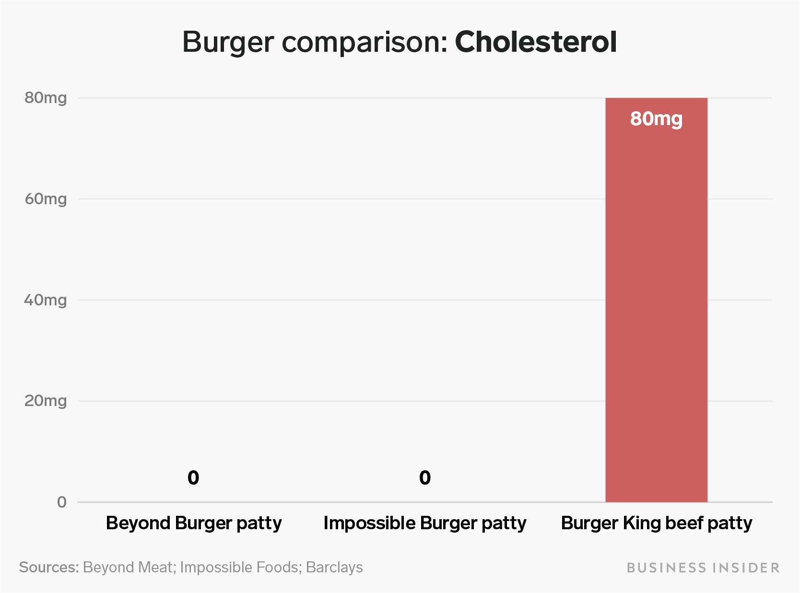
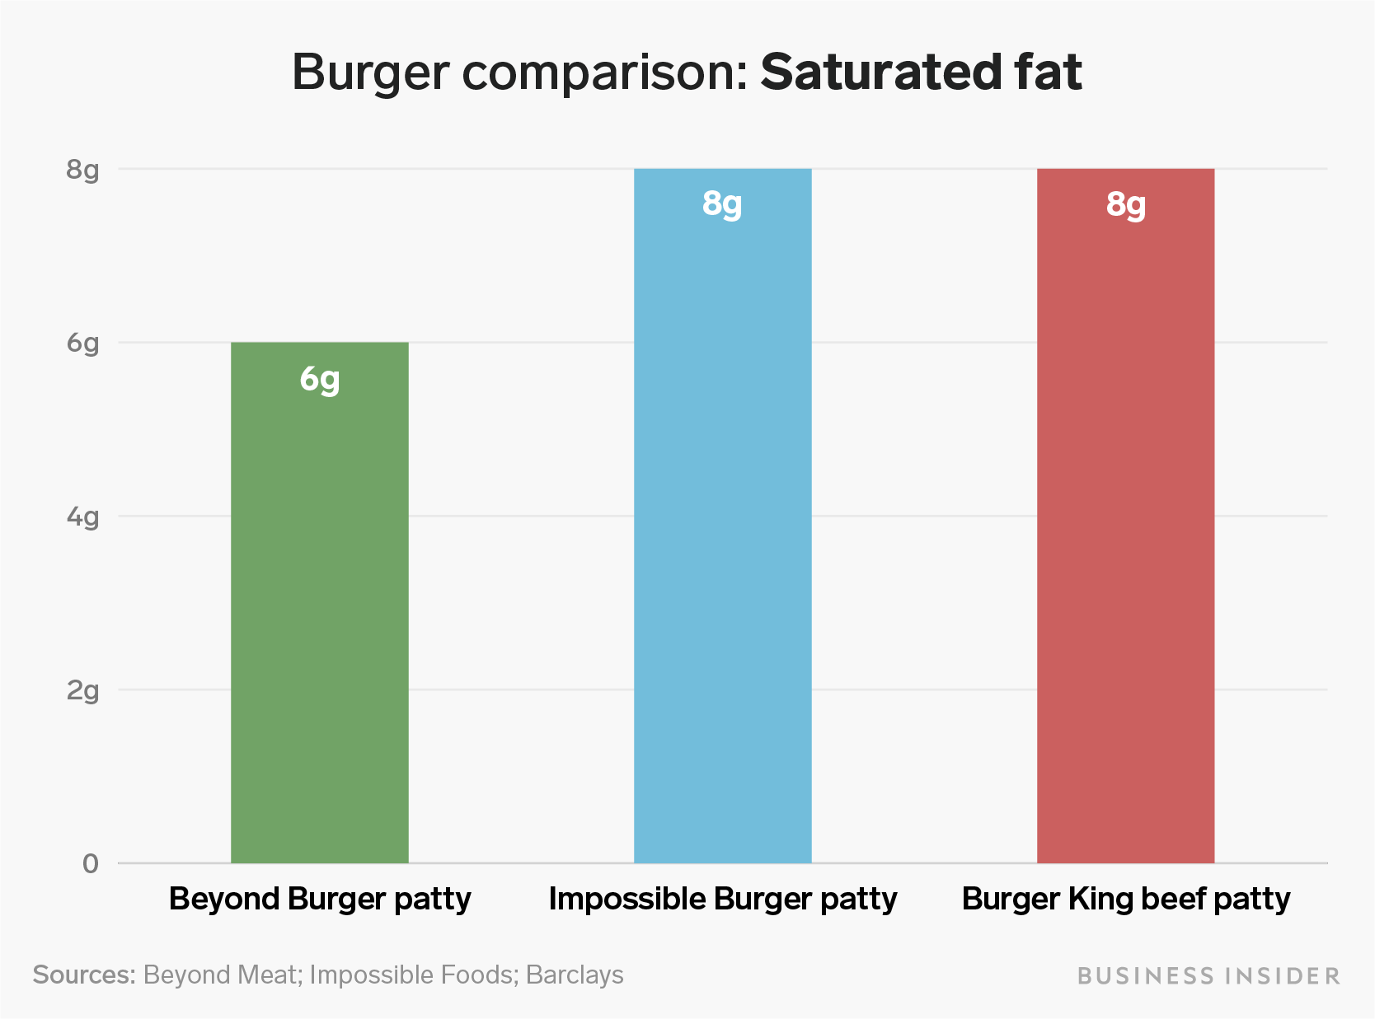
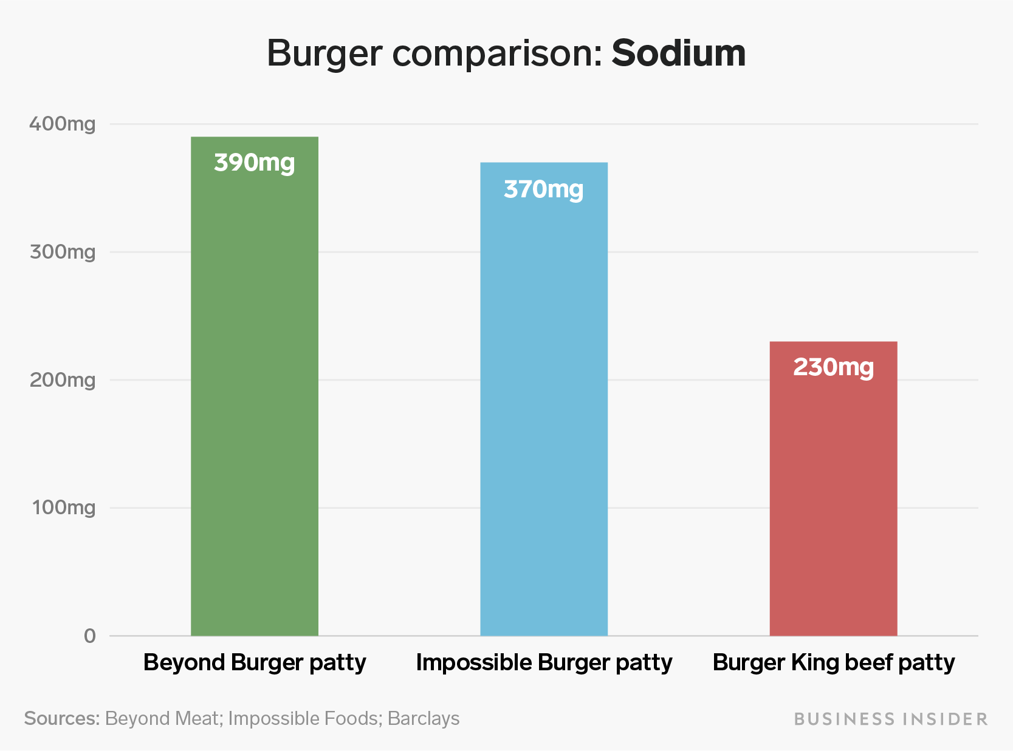
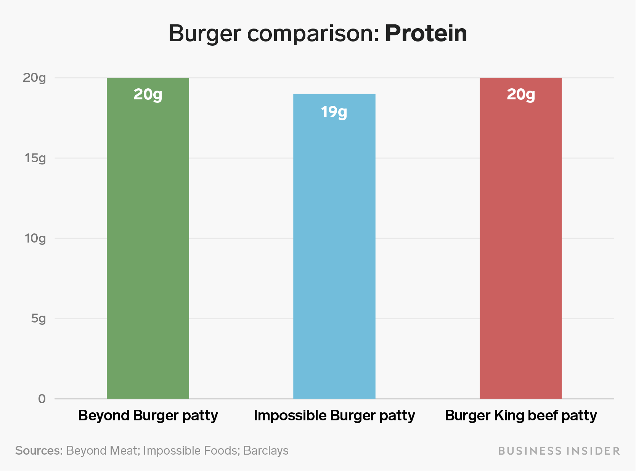
https://www.businessinsider.com.au/beyond-burger-vs-impossible-burger-nutrition-compares-2019-6
Notes:
Comparisons of the nutritional value of the Beyond Burger, Beef Burger and Impossible Burger Patties (Taylor and Gal 2019). From these figures we can see that beef burgers have much higher cholesterol but lower sodium content. The calorie, saturated fat and protein content are fairly similar across the three products.

Slide 8
Planet
 | Units used | Beyond Meat | Beef Burger
Greenhouse gases | Kg CO2 eq. | 0.4 | 3.7
Energy use | MJ | 6.1 | 11.4
Water use | Liter eq. | 1.1 | 218.4
Land use | m^2a eq. | 0.3 | 3.8
41 square plot of land produces 1 beef burger and 15 Beyond Burgers
2,500 gallons of water / 1 pound of beef
2-5 acres of land / cow, 50% of grain is fed to livestock, 56% of water is used for feed crops for livestock in US
US Cows only → 5.27184 billion lbs of waste
Notes:
http://css.umich.edu/sites/default/files/publication/CSS18-10.pdf → University of Michigan
https://www.cowspiracy.com

Slide 9
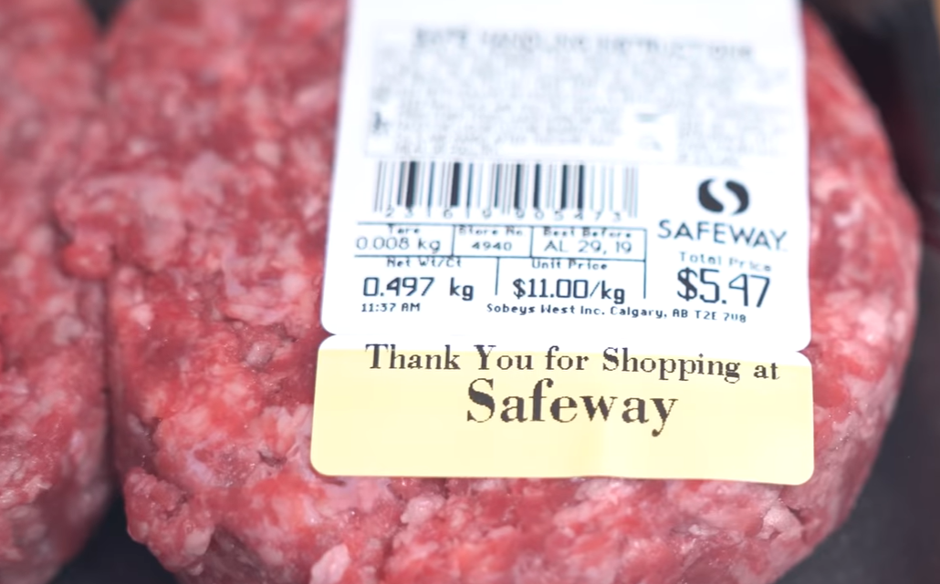
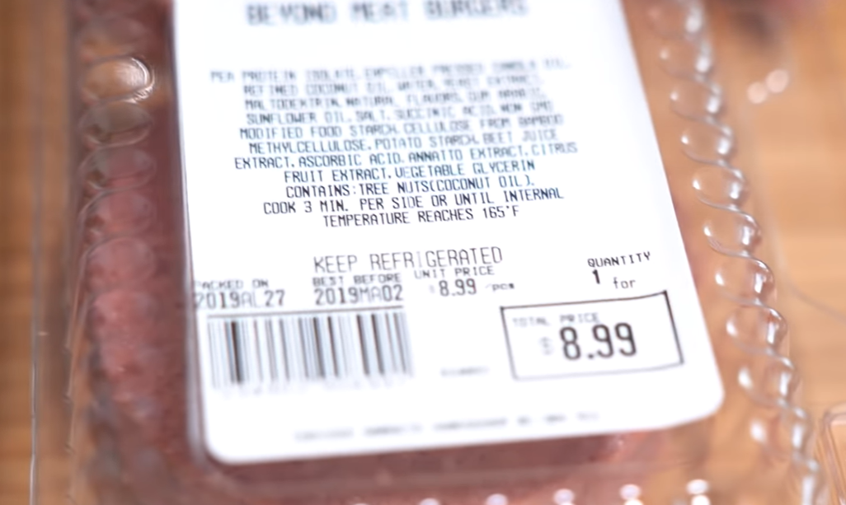
Economics - Price
 | Real meat (ground beef) | Beyond meat
Weight | 497g | 253g
Price | $5.47 | $8.99
The price of beyond meat is higher (almost double) than that of real meat.
Notes:
As demand and technology increases, the price may decrease.

Slide 10
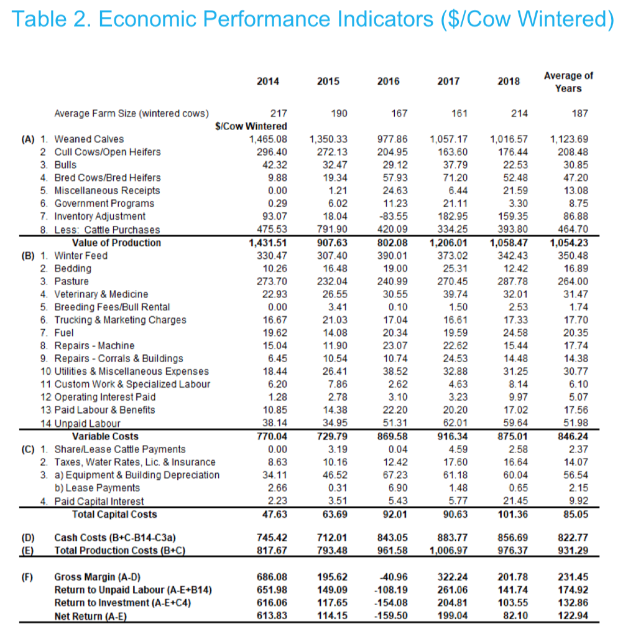
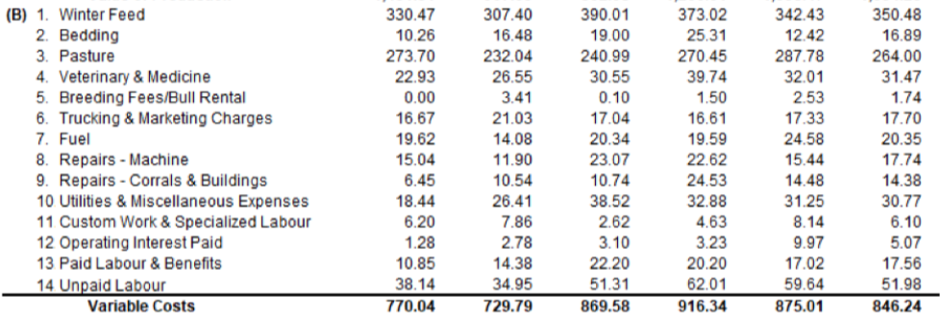
Economics - Production Costs of a Real Beef Burger
The average variable costs of wintering a cow is $846.24 as shown by the Alberta Government in their AgriProfit$ Business Analysis and Research Program.
The variable costs include costs that are related directly to the care of a cow.

Slide 11
Economics - Production Costs of a Real Beef Burger
The average profitability of wintering one cow is only $123.00 as shown by the Alberta Government in their AgriProfit$ Business Analysis and Research Program.
This value is based off of total costs and not just the variable costs.

Slide 12
Economics - Production Costs of a Beyond Meat Burger
No exact numbers could be found.
Although the plant based ingredients of a Beyond Meat Burger are cheaper, the reasons that Beyond Meat Burgers are more expensive are because:
the process of forming the Beyond Meat Burger
the fact that consumers are willing to pay a higher price for it.

Slide 13
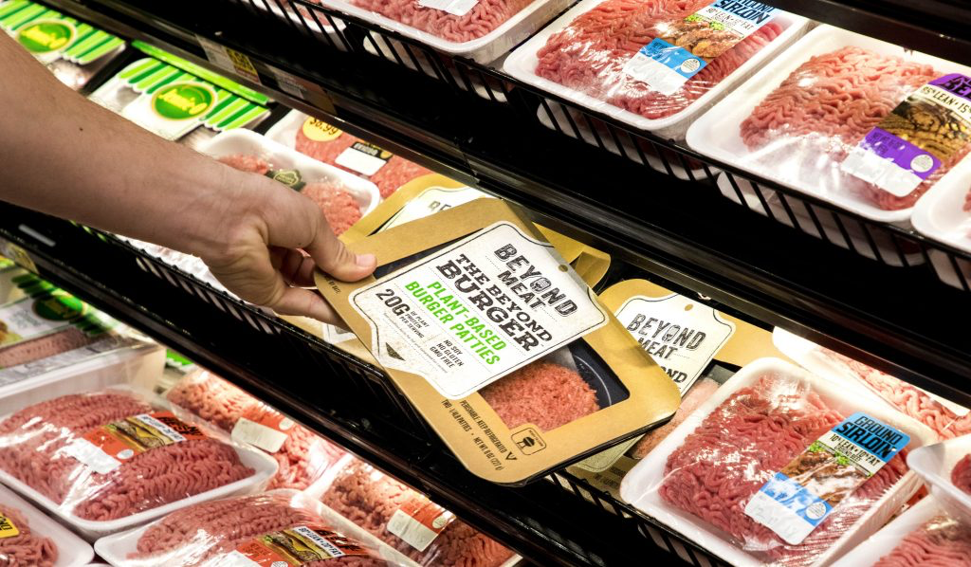
Do YOU think we should we go Beyond Beef?
What are you going to reach for at the grocery store?
https://www.cfo.com/financial-performance/2019/06/beyond-meat-sales-go-beyond-estimates-in-q1/
Depending on the pillar you value most, your answer may vary.

Slide 14
References
Alberta Government. 2019. Economic, productive and financial performance of Alberta cow/calf operations; [accessed 2020 Mar 27].
https://open.alberta.ca/publications/agriprofit-economic-production-and-financial-performance-of-alberta-cow-calf-operations
Anderson K, Kuhn K. [Internet]. 2014. Cowspiracy. Available from: https://www.cowspiracy.com
*Website includes original sources
Beyond Beef®. [accessed 2020 Mar 27]. https://www.beyondmeat.com/products/beyond-beef/
Heller MC, Keoleian GA. 2018. Beyond Meat Beyond Burger Life Cycle Assessment: A detailed comparison between a plant- based and an animal-based protein source. Center for Sustainable Systems University of Michigan. 3(1): 1-41. http://css.umich.edu/sites/default/files/publication/CSS18-10.pdf
Kmietowicz Z. Red meat consumption is linked to higher risk of death from most major causes. Bmj. 2017 Sep. doi:10.1136/bmj.j2241
Red meat and nutrition. [accessed 2020 Mar 27]. http://meatandhealth.redmeatinfo.com/red-meat-and-health-the-facts/red-meat-and-nutrition.aspx
Sabaté J, Soret S. Sustainability of plant-based diets: back to the future. The American Journal of Clinical Nutrition. 2014;100(suppl_1).
doi:10.3945/ajcn.113.071522
Kevany K. 2019. Plant-Based Diets for Succulence and Sustainability. London: Routledge. [accessed 2020 March 26]. p 15-44.
https://doi-org.login.ezproxy.library.ualberta.ca/10.4324/9780429427138
Markets and Markets. 2019. Plant-based meat market by source (Soy, Wheat, Pea, Quinoa, Oats, Beans, Nuts), Product (Burger patties, sausages, strips & nuggets, meatballs), Type (Pork, Beef, Chicken, Fish), Process, and Region- Global Forecast to 2025. [accessed 27 March 2020]. https://www.marketsandmarkets.com/Market-Reports/plant-based-meat-market-44922705.html
Taylor K, Gal S. 2019. How the Beyond Burger and the Impossible Burger actually compare when it comes to calories, sodium and more. [accessed 27 March 2020] https://www.businessinsider.com.au/beyond-burger-vs-impossible-burger-nutrition-compares-2019-6
Notes:
Ones below are from cowspiracy:
Jacobson, Michael F. “Six Arguments For a Greener Diet: How a More Plant-based Diet Could Save Your Health and the Environment. Chapter 4: More and Cleaner Water”. Washington, DC: Center for Science in the Public Interest, 2006.
Dr. George Borgstrom, Chairman of Food Science and Human Nutrition Dept of College of Agriculture and Natural Resources, Michigan State University, "Impacts on Demand for and Quality of land and Water."
McBride, William D., Mathews Jr., Kenneth. "The Diverse Structure and Organization of U.S. Beef Cow-Calf Farms". USDA: Economic Research Service. Number 73. March 2011
https://directives.sc.egov.usda.gov/OpenNonWebContent.aspx?content=31475.wba
"Executive Summary: Feed Supply". Food and Agriculture Organization of the United Nations.

